Slide 1
A PROJECT ON WEB BASED MATHEMATICS TOOL
PREPARED BY:
Aram Abbasi
Shiva Pandey
Shyam Raja Bhetuwal
GROUP-10 (DIN17SP)

Slide 2





TOOLS USED FOR THIS PROJECT
VISUAL STUDIO CODE
GOOGLE CHROME
GITHUB
MICROSOFT PROJECT
BALSAMIQ

Slide 3
FUNCTIONS INCLUDED IN THIS PROJECT ARE
NUMBER SYSTEM CONVERSIONS
NUMBER SYSTEM OUTPUTS
COMBINATORICS
TRUTH TABLE
RANDOM VALUES
CHESS

Slide 4
NUMBER SYSTEM CONVERSIONS
Converts From one number system to other three.
Choose one numbering system to input value.
Just click on input buttons to give input value .
After giving input it will convert number automatically.
Click clear button to input different value as you need.

Slide 5

NUMBER SYSTEM OUTPUTS
Give values of decimal numbers from 0-50 in BIN, OCT and HEX systems.
By clicking on create table it gives values in tabular form.
By clicking in clear button we can clear table .

Slide 6
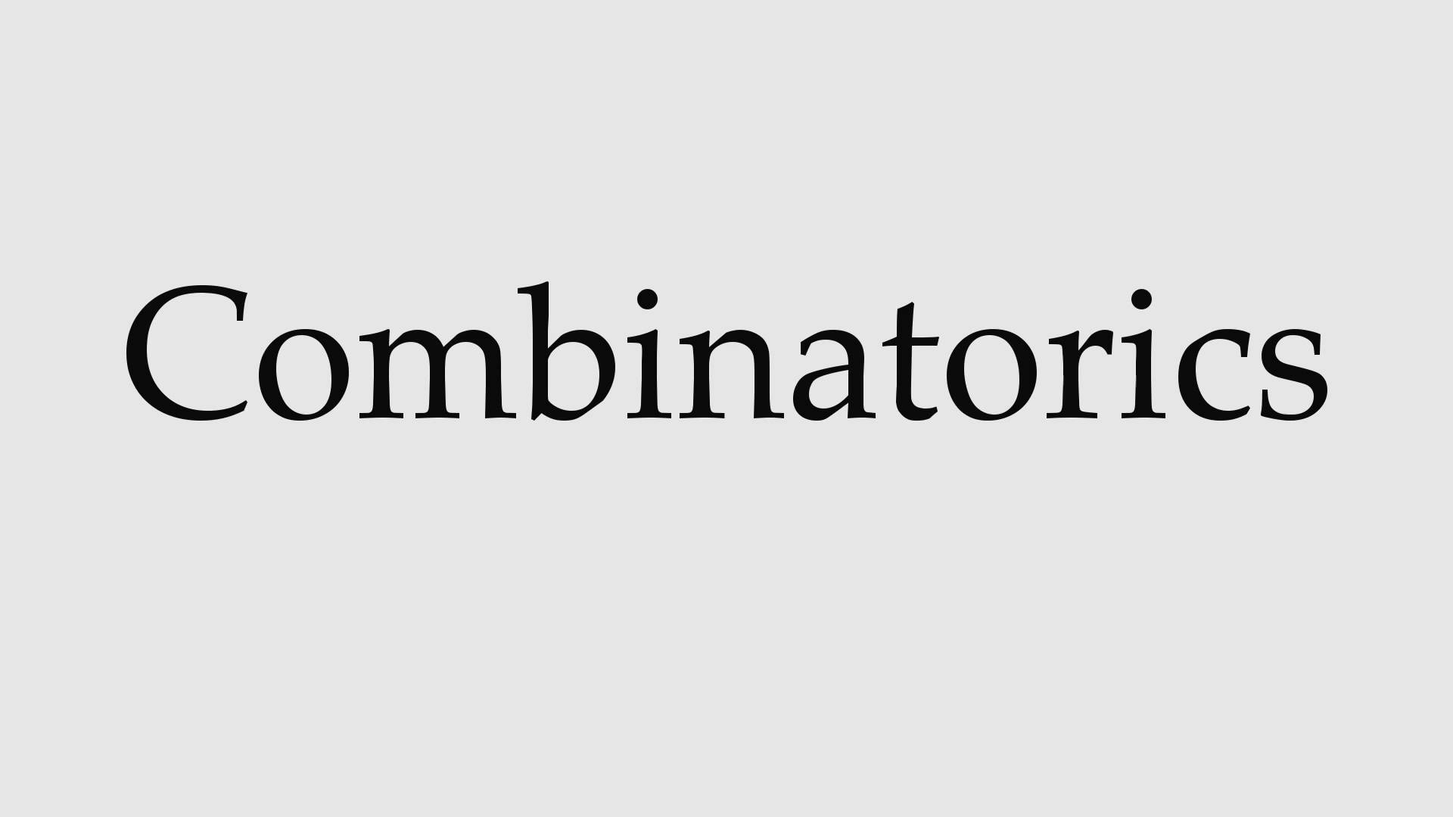
Calculates either permutations or combinations on user’s choice.
Permutation can be calculated with or without replacement.
Users can give input values for m and n from combo box.
Click on calculate button to give result value.

Slide 7

It is logic based mathematical table.
It gives us outcome value of possible scenario.
We can mention what we want to calculate by giving input in find button.
We can change what to find in text input of find button.

Slide 8
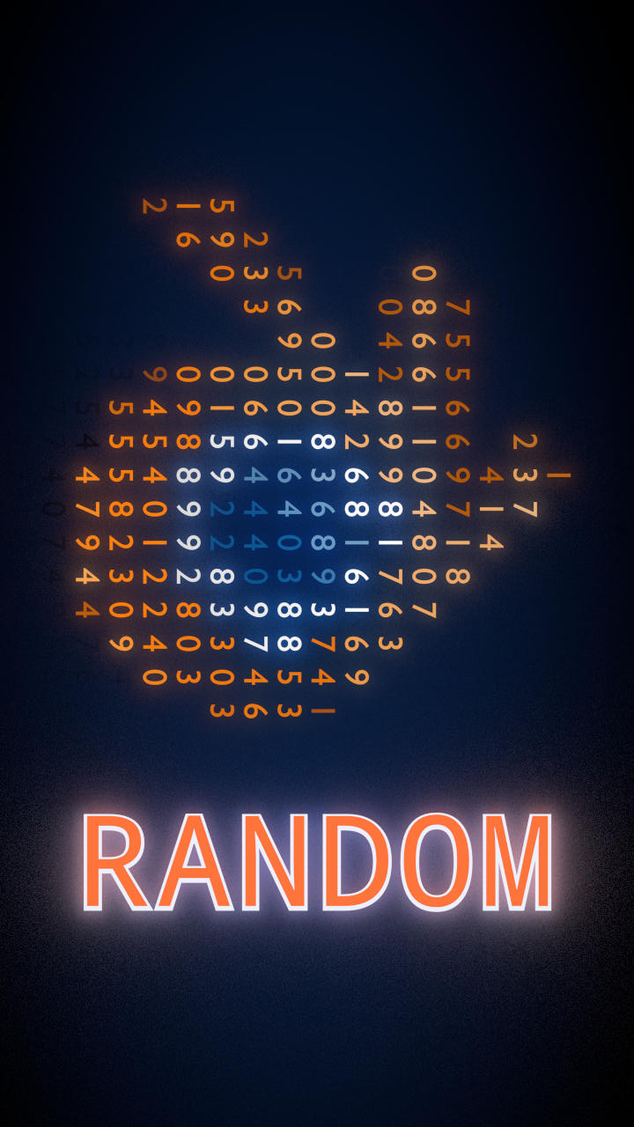
User can create random values from this tool.
Random values can be created as user wants.
User can give input to create random values as many times as they want.

Slide 9
CHESS
Users can have experience to view the number of possible ways a Knight can move in checkbox.
User can start by clicking one of the board shell.

Slide 10

Any Questions??

